Slide 1
Gale Interactive: Science

Slide 2
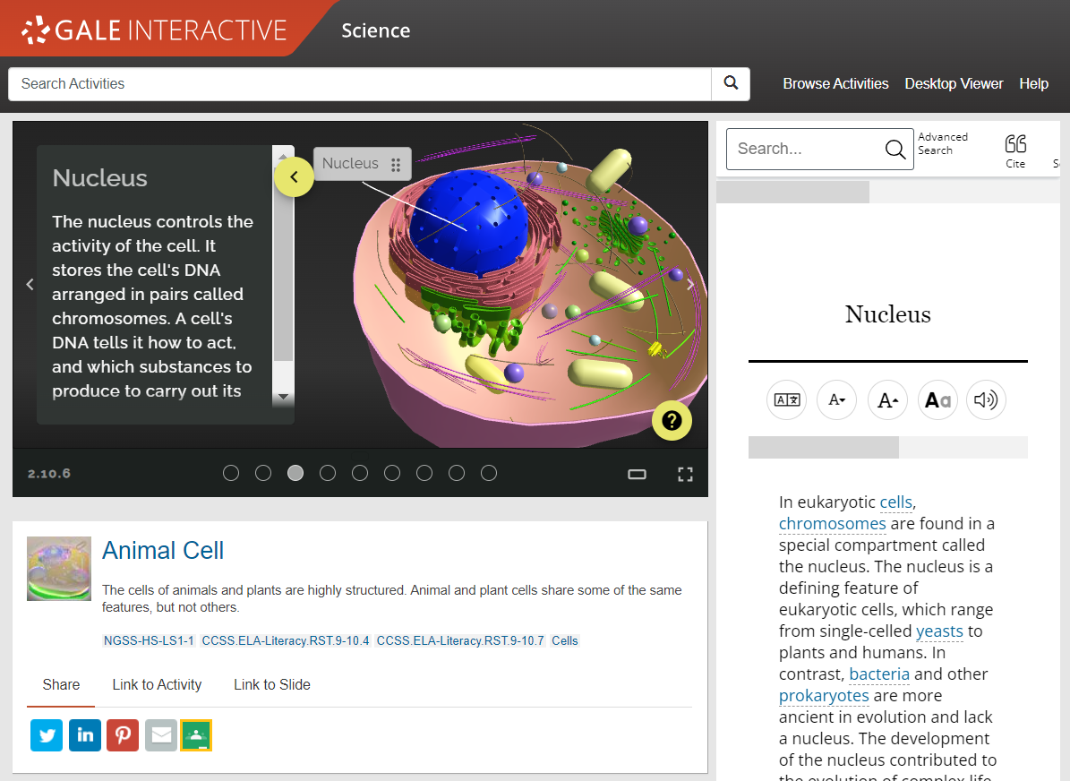
GALE INTERACTIVE: SCIENCE
INTERACTIVE MODELS FOR HIGH SCHOOL AND BEYOND
Over 200 models in core science subjects including Biology, Chemistry, Earth Science, and Human Anatomy.
SUPPLEMENTAL CONTENT
Reference materials and 3D printing files support a deeper understanding of the topics.
SHARE THE INFORMATION
Send activities to patrons, or link in your social media accounts.
Notes:
Gale Interactive: Science gives middle and high schoolers the power to see science beyond static text. With over 200 interactive sessions and 60 models to print with a 3D printer, learners are inspired to achieve the ultimate outcome—discovery.
Cover biology, chemistry, human anatomy, and earth science with supplemental content from other resources such as Gale In Context: Science and Gale OneFile.
Extend the reach of your resources. Integrated G Suite for Education and Microsoft Office 365 tools enable users to easily share, save, and download content— including highlights and notes.

Slide 3
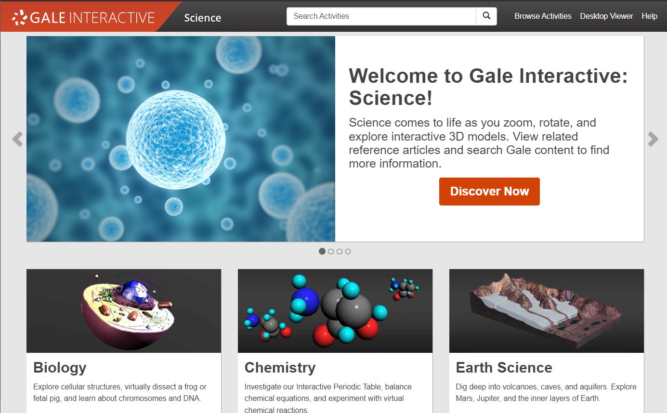
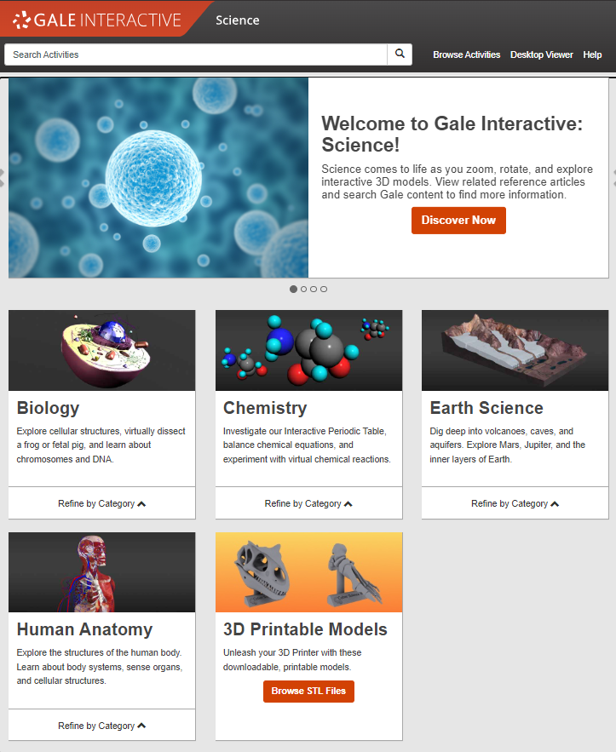
ACCESS ANYWHERE
Anytime
Anywhere
Any Device
Without Ads or Paywalls
WWW.LIBRARYRESOURCESURL.EDU
Notes:
Customize the library access URL on this slide before presenting.
All of the content in Gale Interactive: Science can be accessed by you and your learners 24/7 on any device, no matter where you are. Your entire class can look at the same interactive at once without problems, and there are no limits to the amount of content you can access.
Additionally, Gale Interactive: Science is an ad-free environment that provides full-text access without paywalls.

Slide 4
INTEGRATE INTO YOUR LMS
Notes:
The next few slides cover discovery within Canvas. If you are utilizing this LMS unhide these slides, if not you can keep them hidden during your presentation. Remember: integrating into your LMS means your users will automatically authenticate into Gale Interactive: Science when selected.

Slide 5
CANVAS
ACCESS THROUGH COURSE HOME
Your integrated Gale resources will appear in the tool bar on the left.
Notes:
To select a resource added to a course users will need to select the course and choose the correct resource from those added to the left side tool bar.

Slide 6
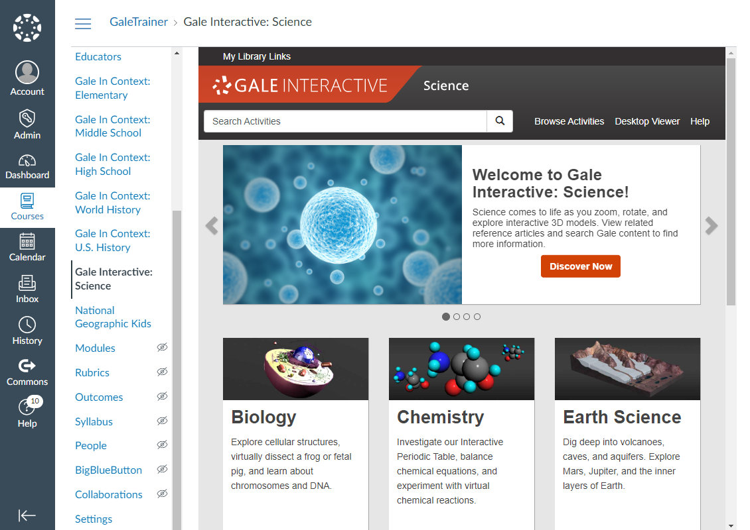
CANVAS
ACCESS THROUGH COURSE HOME
Your integrated Gale resources will appear in the tool bar on the left.
Selecting a resource will open it within the Canvas interface.
Notes:
To select a resource added to a course users will need to select the course and choose the correct resource from those added to the left side tool bar.
Selecting the Gale Interactive: Science option will launch them straight into the resource, while keeping them in the Canvas interface.

Slide 7
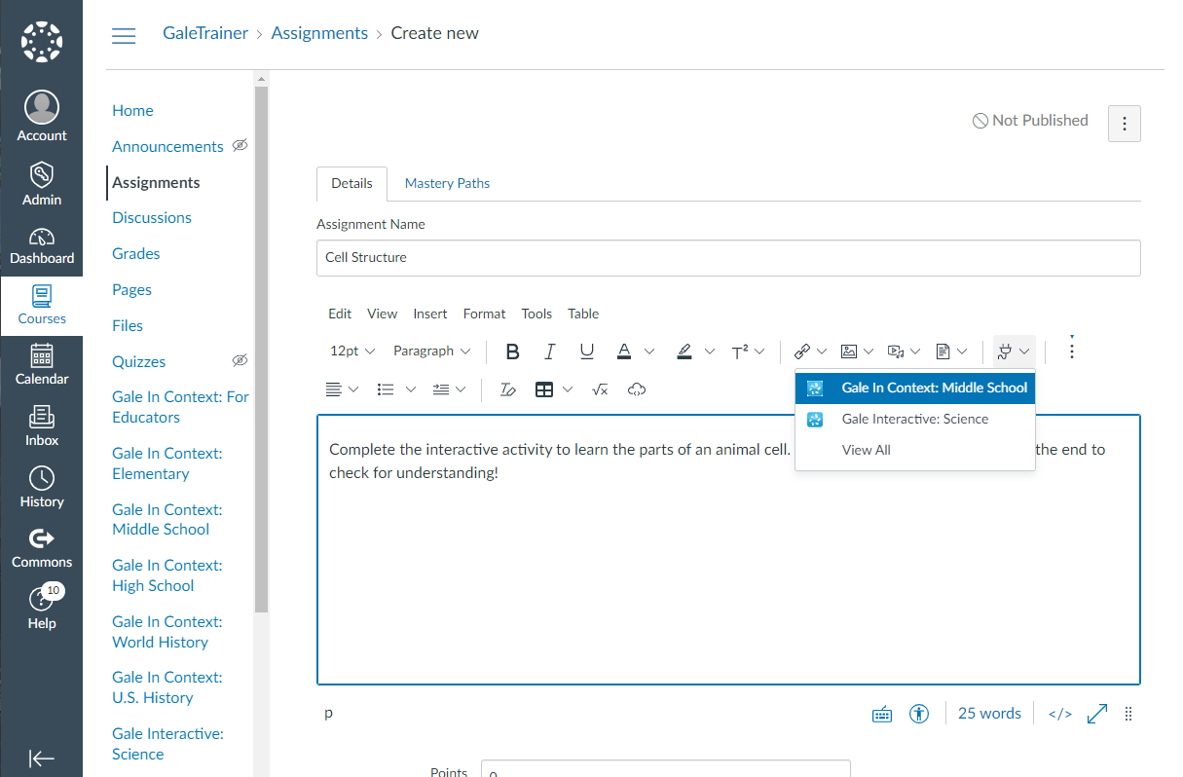
CANVAS
ACCESS THROUGH MATERIALS
When creating or editing a material, select the Apps drop down in the Details section and choose your resource.
Notes:
To access resources while creating or editing a material (like an assignment or discussion post) teachers will select the Apps option at the top of the Details dialogue box. The drop down will have Gale Interactive: Science listed.

Slide 8
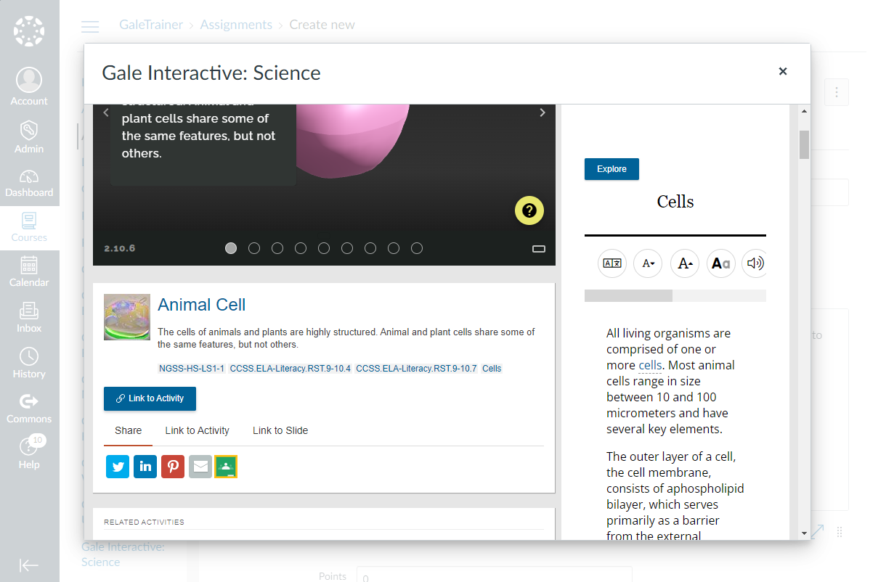
CANVAS
ACCESS THROUGH MATERIALS
When creating or editing a material, select the Apps drop down in the Details section and choose your resource.
The resource will open within Canvas. Utilize the Link to Activity button to add content to your material.
Notes:
Gale Interactive: Science users can Link to Activity. Selecting Link to Activity will enter a URL into the material that others will be able to select.

Slide 9
DISCOVER PREMIUM SCIENCE ACTIVITIES & CONTENT

Slide 10
Search or Browse
Explore Content
Share Activities
Notes:
It’s easy to access all the premium content within Gale Interactive: Science by browsing or searching for topics of interest, exploring content organized by topic, and then clicking individual result titles to view and use activities, reference content, and more.

Slide 11
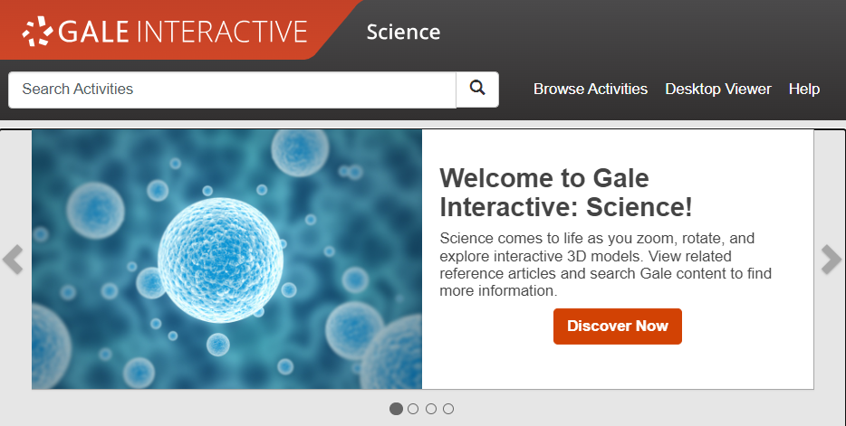
SEARCH
Enter simple search terms to see related activities
Notes:
To perform a basic search, just enter key terms related to topics of interest in the search box on the homepage or at the top of every page throughout Gale Interactive: Science.

Slide 12
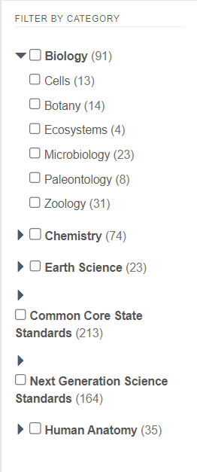
BROWSE
Browse all activities organized by topic
Notes:
In addition to searching, Gale Interactive: Science is designed to make it easy to browse for activities of interest. Simply click the Browse Activities option in the upper right corner of the homepage and on many other pages throughout Gale Interactive: Science to access a list of all Categories for which there are interactive activities. Simply click the arrow next to a Category to see the specific topics within and how many activities are related to each.

Slide 13
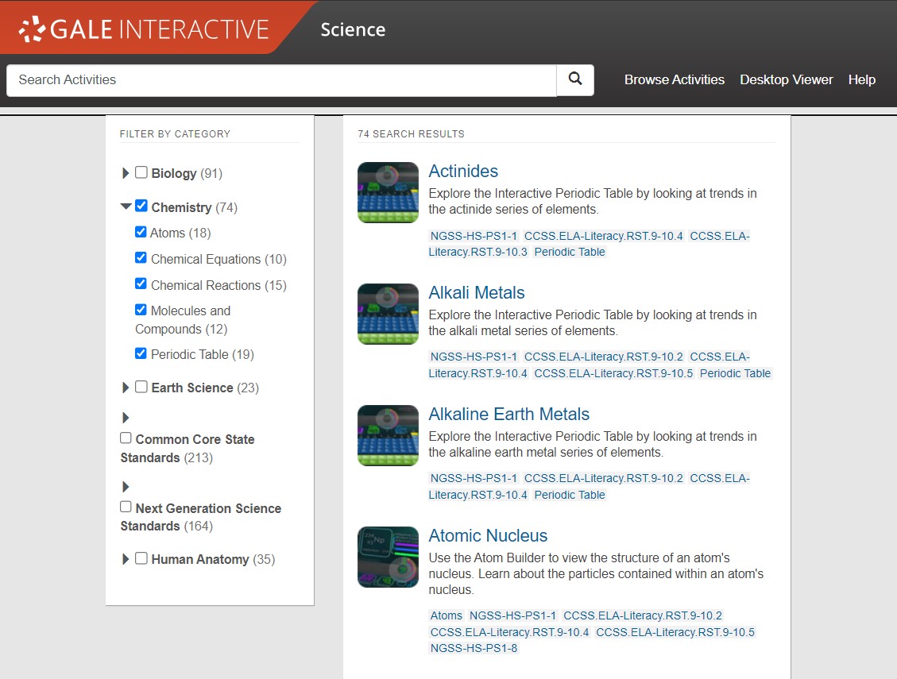
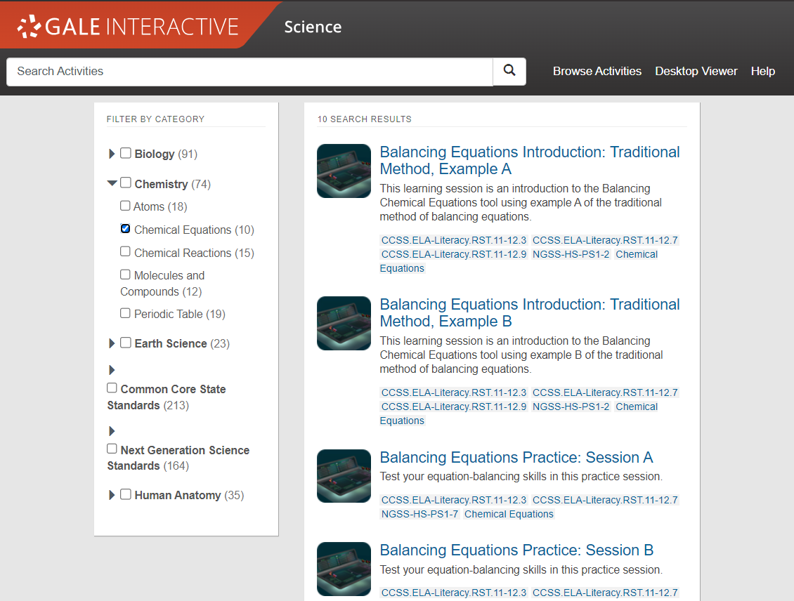
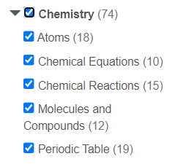
BROWSE
Browse all activities organized by Category
Browse by Category
Select one of the main categories to browse all available content related.
Notes:
You can browse activities by larger categories like Chemistry, Biology, Human Anatomy, and Earth Science. Simply check the box next to a category and it will automatically select all Topics within.

Slide 14
BROWSE
Browse all activities organized by topic
Browse by Category
Select one of the main categories to browse all available content related.
Browse by Topic
Narrow results by selecting a more specific topic within a category.
Notes:
You can also narrow your browsing by selecting one or more topics at a time. There is no limit to how many topics can be selected at once and they also can come from different categories.

Slide 15
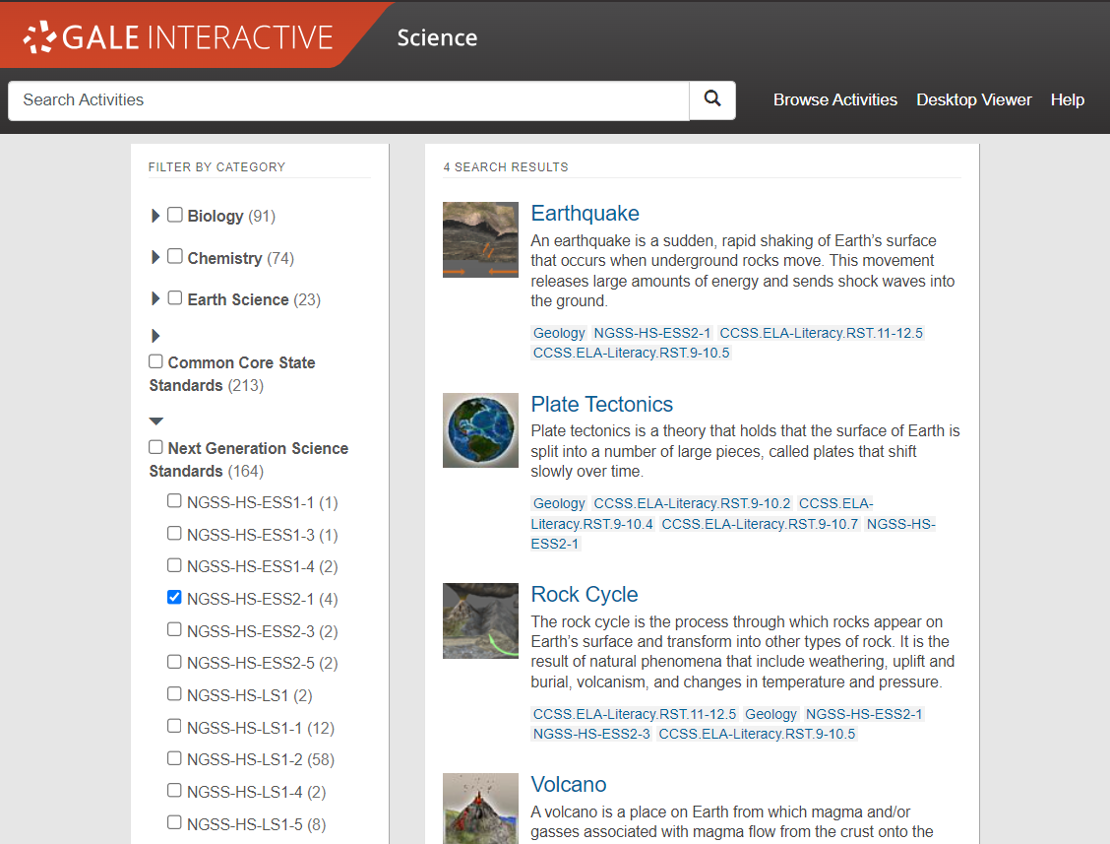
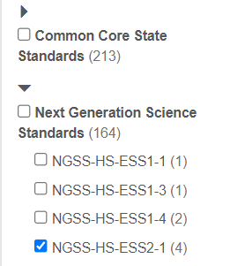
BROWSE
Browse all activities organized by Standard
Browse by Category
Select one of the main categories to browse all available content related.
Browse by Topic
Narrow results by selecting a more specific topic within a category.
Browse by Standard
All activities are aligned to Common Core and the Next Generation Science Standards. Select a standard to see the corresponding activities.
Notes:
Finally, you can browse activities by the NGSS and Common Core Standard they are aligned to. All activities have standards listed that you can view as you are browsing.

Slide 16
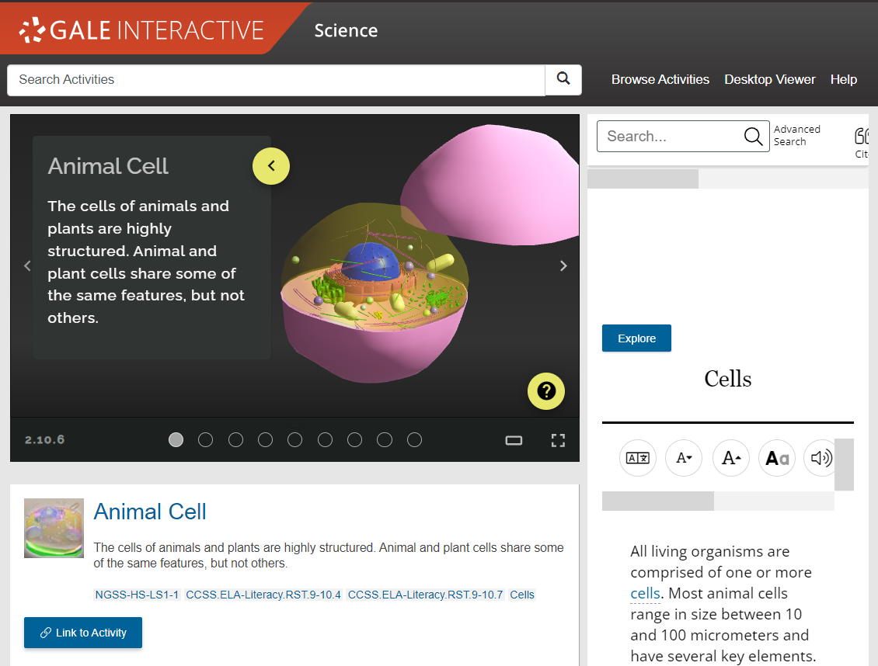
EXPLORE CONTENT
Help is Always Available
Select the “Help” tool to open on screen prompts that will walk you through how to navigate any interactive simulation.
Notes:
An easy way to orient yourself with an activity is to follow the on-screen prompts that start after selecting the “help” tool. This appears as a yellow question mark within each activity screen and will walk you through how to interact with an activity.

Slide 17
EXPLORE CONTENT
Help is Always Available
Select the “Help” tool to open on screen prompts that will walk you through how to navigate any interactive simulation.
Options to View
Display options can be changed from Default View to a Theatre View and Full Screen option.
Notes:
There are three different options to view an activity. Every activity will open in “Default View” as seen here but you can enlarge this to two other options. “Theatre View” spreads the activity screen across the width of the screen and pushes all other content underneath. “Full Screen” gives you a more immersive experience and you cannot access other content until you exit it.

Slide 18
EXPLORE CONTENT
Help is Always Available
Select the “Help” tool to open on screen prompts that will walk you through how to navigate any interactive simulation.
Options to View
Display options can be changed from Default View to a Theatre View and Full Screen option.
Navigate Through Slides
Minimize on slide content to better view an activity by clicking the yellow arrow. Click through sides using side arrows.
Notes:
Most activities in Gale Interactive: Science are set-up as slides you will progress through with on screen content that pairs with it. To minimize the on-screen content and view an activity more clearly, simply click the yellow arrow and it will collapse. To move to another slide, you can click the arrows on the left and right or you can hop to a slide by using one of the circles at the bottom.

Slide 19
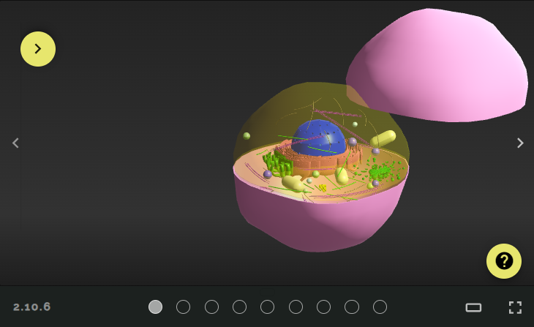
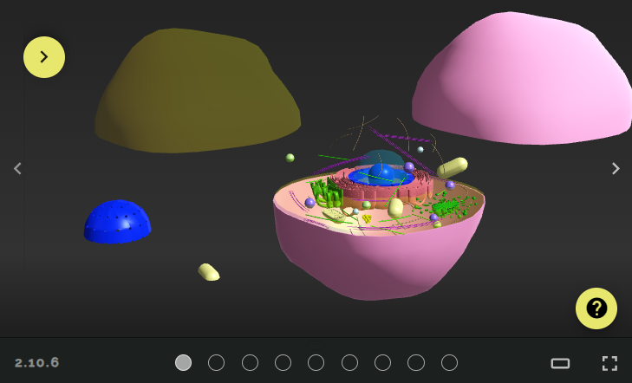
EXPLORE CONTENT – ACTIVITY NAVIGATION
Manipulate model pieces by left clicking and dragging items out of the way.
Notes:
There are several ways you can manipulate an activity, simply by using your mouse. First, you can move pieces out of the way or move an entire model around the screen by left clicking and dragging.

Slide 20
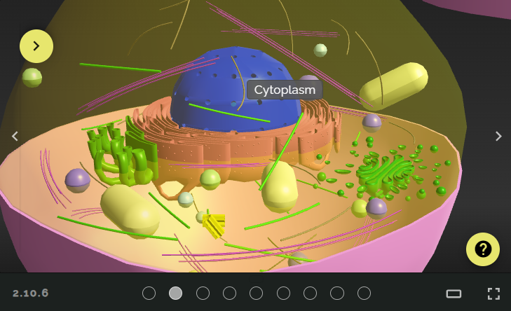
EXPLORE CONTENT – ACTIVITY NAVIGATION
Scroll up to zoom in closer & improve your view. Scroll down to zoom back out.
Notes:
Improve your view by scrolling up to zoom in. Scroll down to zoom back out.

Slide 21
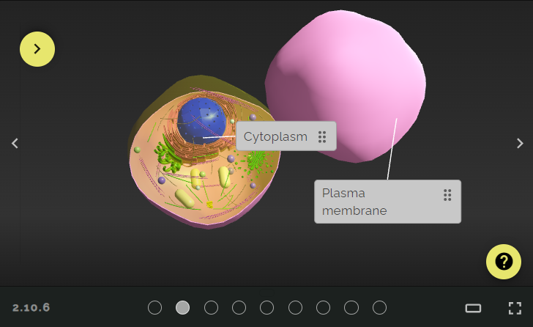
EXPLORE CONTENT – ACTIVITY NAVIGATION
Right click and drag your mouse to change the angle of your view.
Notes:
Right click and move your mouse to change the angle of your view.

Slide 22
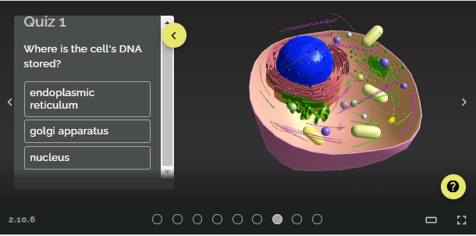
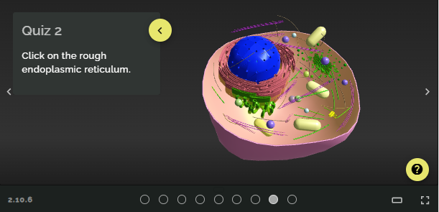
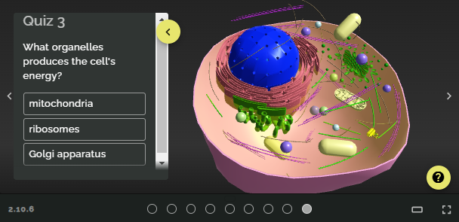
EXPLORE CONTENT
Check for Understanding
At the end of an activity you may find several “Quiz” questions that will assess concepts covered in the interactive.
These questions may be multiple choice, true/false, or even ask you to interact with the model to answer.
Notes:
Some interactive activities come with quiz questions to answer at the end to check for understanding. These questions allow multiple attempts and do not record scores, allowing users a low-stakes way to check for understanding and evaluate if they are ready to move on.

Slide 23
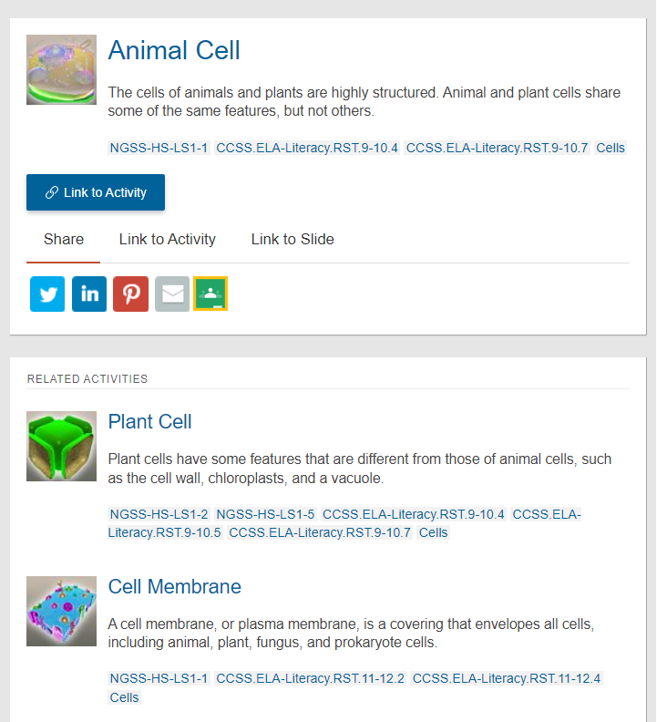
EXPLORE CONTENT
Find Related Activities
Scroll down on an activity page to view recommended activities that address similar concepts or standards.
Quickly preview these activities with description given to the right and standards listed underneath each.
Notes:
Under every activity are related activities you can use to continue learning. This may address the same standard, be in the same category, or just be of a similar interest.

Slide 24
EXPLORE CONTENT
MODELS
LAB TABLES
3D PRINTING
Notes:
There are several different types of activities available in Gale Interactive: Science like models, lab tables, and even 3D printing files!

Slide 25
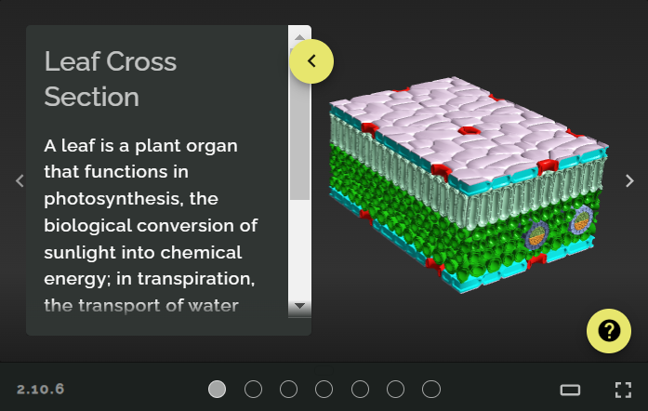
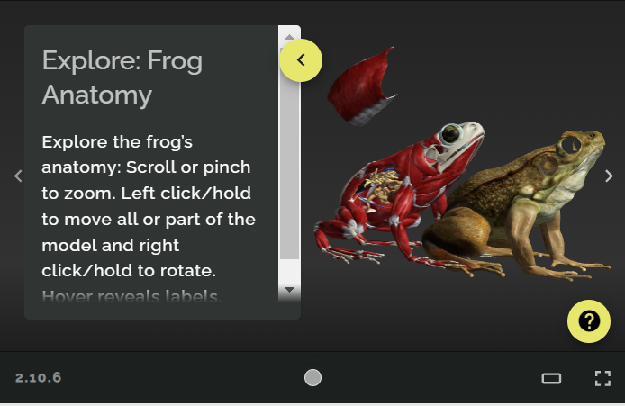
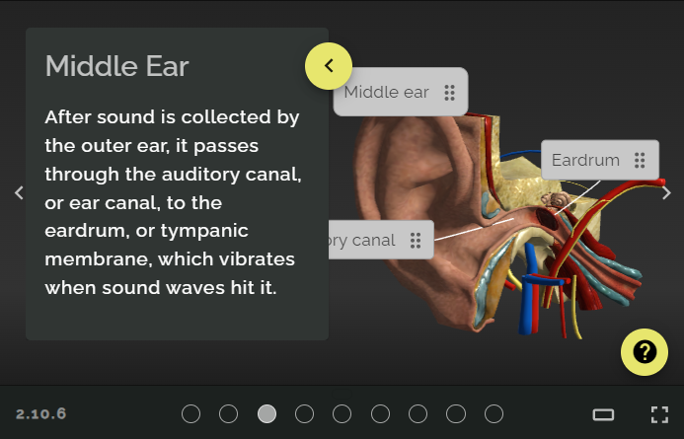
EXPLORE CONTENT
MODELS
Take concepts that are hard or even impossible to see with the naked eye and make them interactive with the large selection of models available.
Models also include many animals offering an alternative for those opposed to dissection or as a cost-effective and time-saving option.
Notes:
Many of the activities within Gale Interactive: Science are models that can be manipulated and cover a wide array of topics. These are perfect for concepts that are hard to see and complex to understand. The step-by-step approach most activities follow walks user through each model and breaks them down by layer.
You will also find many animal models within the “Zoology” topic that are an excellent alternative to dissection as a cost and time saving measure.

Slide 26
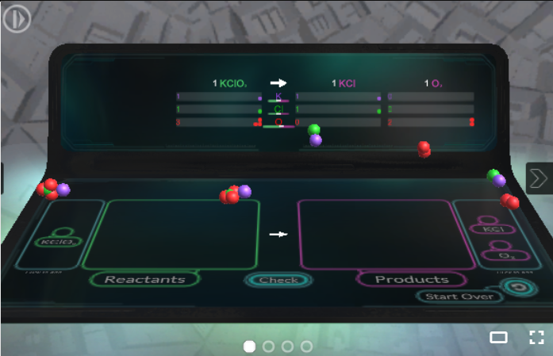
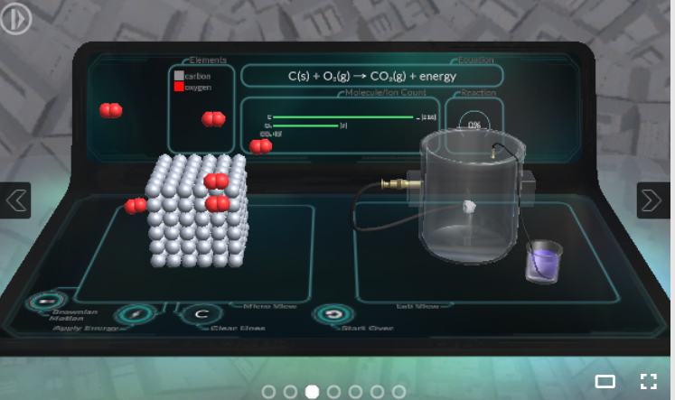
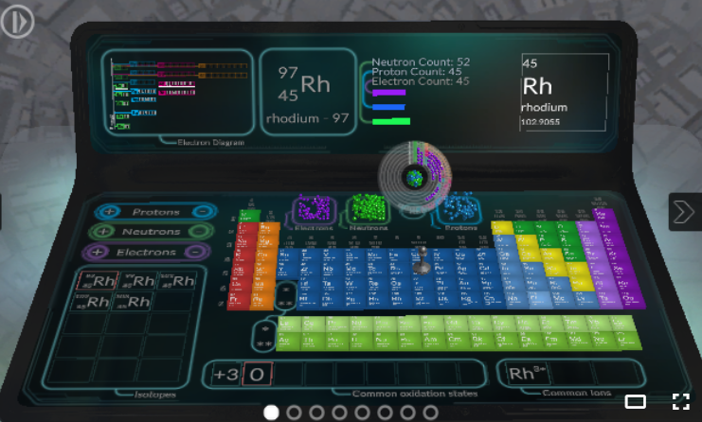
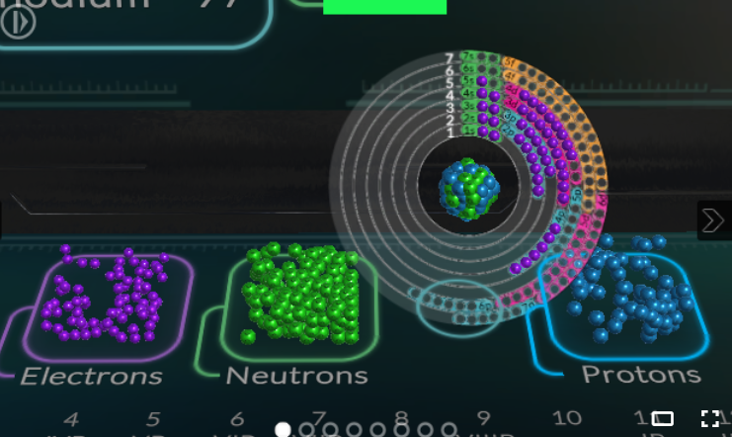
EXPLORE CONTENT
Balancing Equations
LAB TABLES
Explore many topics within Chemistry using Lab Table activities that bring Chemical Equation Balancing & the Periodic Table to life!
Combustion
Atomic Structure
Notes:
Within the “Chemistry” category you’ll find many lab table activities that are great for visualizing atomic structure, chemical properties, and chemical equations. These follow an investigative approach and allow users to learn through trial and error as there are unlimited attempts for every activity.

Slide 27
EXPLORE CONTENT
3D PRINTING
Make your 3D learning world come alive with these 3D printable models.
Create real life versions of over 60 make-it-yourself projects, ranging from a tapeworm to a turbine engine to human body parts!
Notes:
In additional to online content, Gale Interactive: Science comes loaded with 3D printing files for many of the interactive model activities so they can be printed and brought to life!

Slide 28
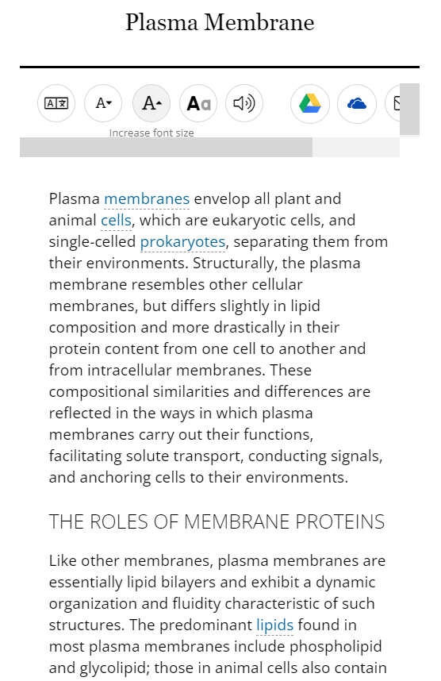
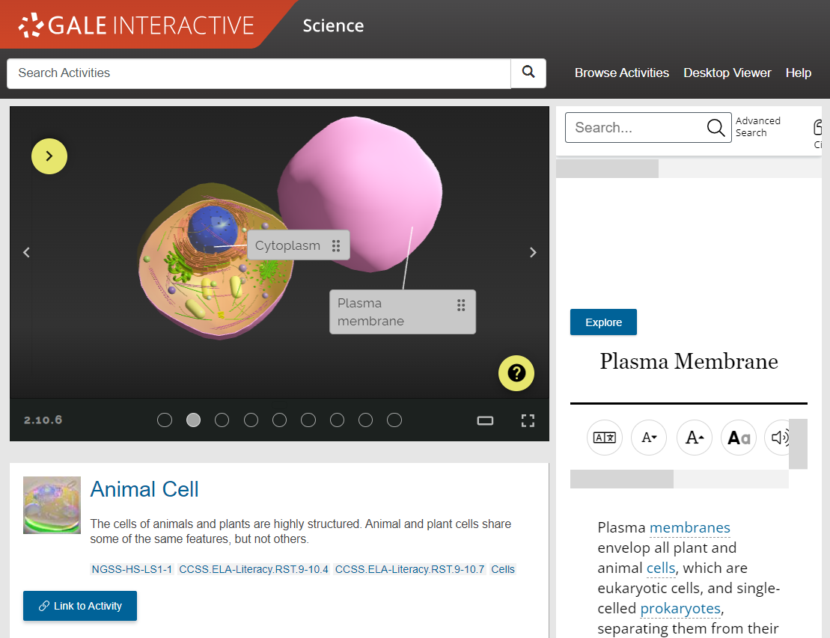
EXPLORE CONTENT – SUPPLEMENTAL TEXT
Paired Reference Content
In addition to the on-slide content, each slide is paired with a specific piece of reference content. This content changes based on the focus of the current slide and reinforces the concepts being taught.
Notes:
In addition to the content given in an activity, you will also have reference content available that is intentionally paired with every slide. The reference content displayed changes to match each individual slide’s topic and is meant to allow for a deeper connection to the activity.

Slide 29
SUPPORT ACCESSIBLE LEARNING
TRANSLATE
Machine translate articles– 40+ languages
FONT SIZE
Increase or reduce as needed
TEXT MANIPULATION
Edit the font style, color, and spacing
LISTEN
Hear text read aloud, and download as an MP3
Notes:
Listen to the article with settings to highlight words and sentences being read, change the speed, and enhance the visibility.

Slide 30
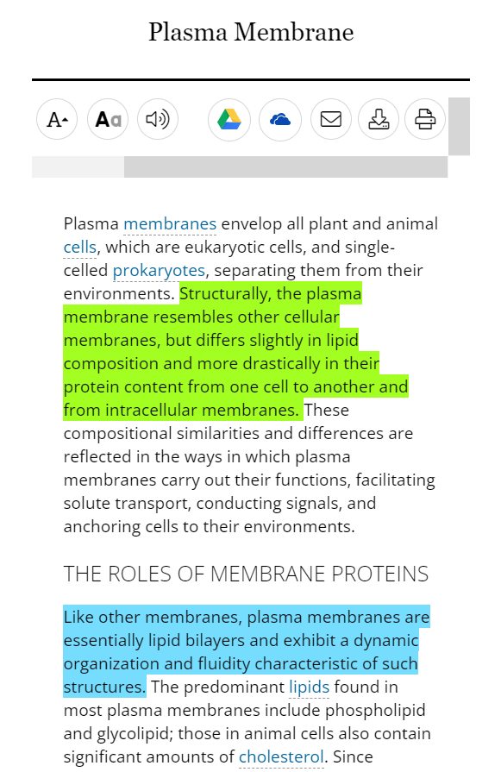
ENCOURAGE ANALYSIS
STEP 1
SELECT TEXT
Click and drag mouse on computer;
Tap on tablet or mobile device
ADD HIGHLIGHTS AND NOTES
Choose color and type annotations in pop-up menu
STEP 2
EXPORT
Add as many notes as desired Download, Print, or Send to… Email, Google Drive or OneDrive before closing
STEP 3
Notes:
Finally, be sure to take the highlighted item with you before you close the resource by downloading, printing, or sending the item to Google Drive or Microsoft OneDrive. This will provide a copy of the result including any highlights and notes you made within the document.
Note that you can also access the Highlights and Notes menu option in the upper right-hand corner of the resource to access all the highlights and notes you’ve made within a given session. This allows you to easily jump to articles and edit highlights and notes, or to download, print, or send a full list of all your highlights and notes to Google Drive or Microsoft OneDrive. Again, if you plan to use this tool, be sure to download, print, or Send to… before exiting the resource.

Slide 31
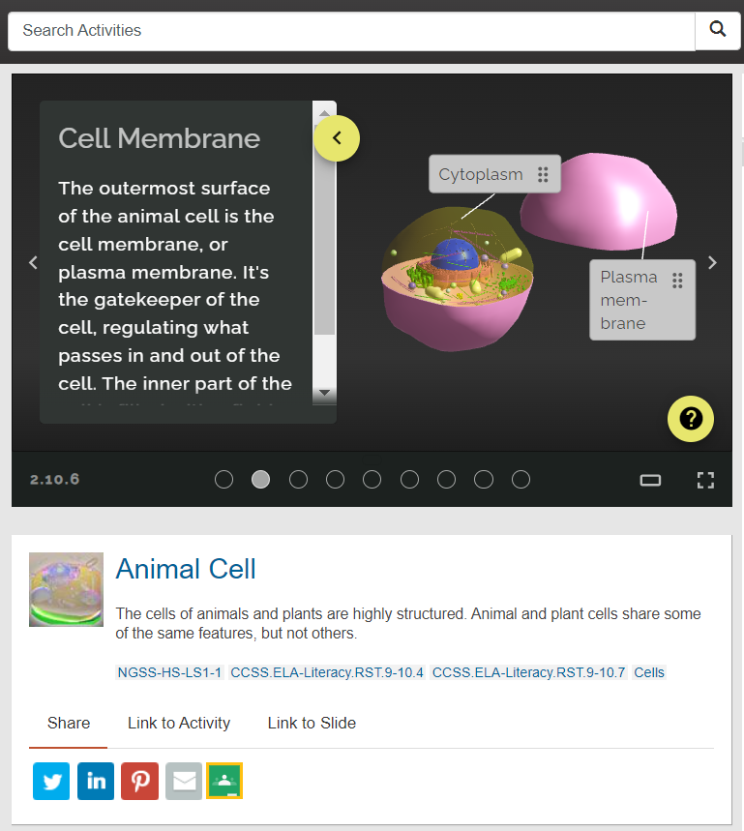
SHARE ACTIVITIES
Social Media, Email, & Google
Share activities directly to your social media accounts, email, or create and assignment in Google Classroom using the appropriate icon.
Notes:
Share an interactive directly to social media, email, or your Google Classroom with the embedded icons. Selecting any will open log-in prompts to access your account and share whatever activity you are on.

Slide 32
SHARE ACTIVITIES
Social Media, Email, & Google
Share activities directly to your social media accounts, email, or create and assignment in Google Classroom using the appropriate icon.
Get a Link
Generate a shareable link to an activity or even a specific slide.
Notes:
You also have the option to generate a shareable link that can bring someone to the beginning of the activity or to a specific slide of your choice. To link to a slide, make sure you are on the slide you want to bring users to when you generate it.

Slide 33
?
…
Notes:
Use this slide as a visual prompt for final questions and/or discussions

Slide 34
WHAT’S NEXT?
EXPLORE GALE INTERACTIVE: SCIENCE
SHARE WITH STUDENTS
CONTACT THE LIBRARY!
Notes:
Wrap up– ask teachers to visit the resource, share articles with students, and contact the library for support

Slide 35
Connect FOR MORE IDEAS
ENTER LIBRARIAN NAME
emailaddress@school.edu
LIBRARY WEBSITE
www.librarysite.edu
SUPPORT.GALE.COM/TRAINING
Lesson plans, tutorials, scavenger hunts, and more
Notes:
Customize this concluding slide with your contact and site/access information.

